Slide 1



DESCRIPTIVE STATISTICS
Knowledge and solutions for a changing world
Advancing data-intensive discovery in all fields
Be boundless
UW DIRECT
(Data Intensive Research Enabling Cutting-edge Tech)
https://uwdirect.github.io
Stéphanie Valleau
Chemical Engineering

Slide 2
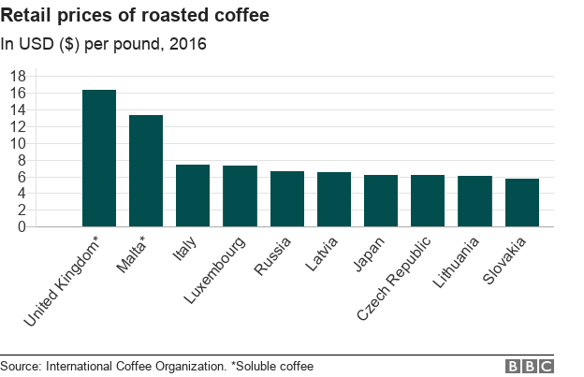

What is statistics?
The practice or science of collecting and analyzing numerical data in large quantities, especially for the purpose of inferring proportions in a whole from those in a representative sample.
https://multimedia.journalism.berkeley.edu/tutorials/databases-of-statistical-information/

Slide 3

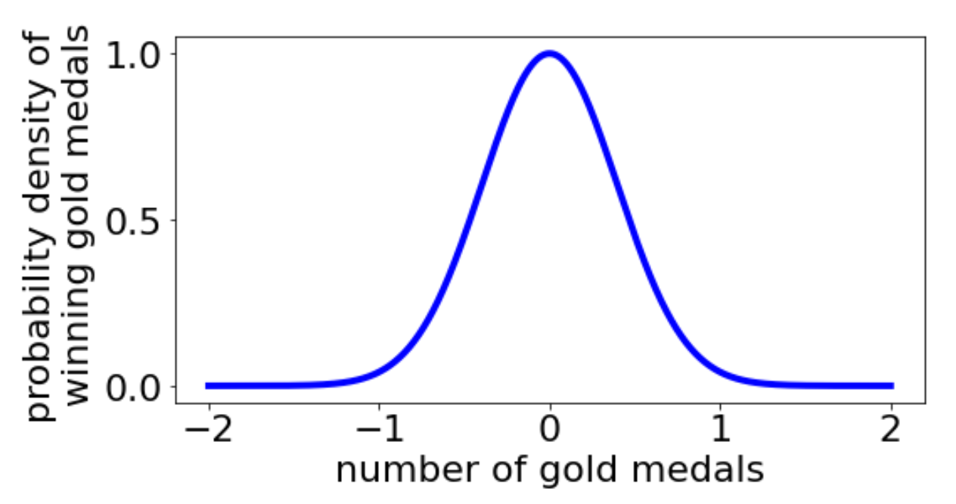
What can we learn from Stats?
Statistics does not tell us whether we are right in coming to a conclusion (not absolute).
It tells us the likelihood of an outcome / the chances of being wrong
most likely value
unlikely

Slide 4
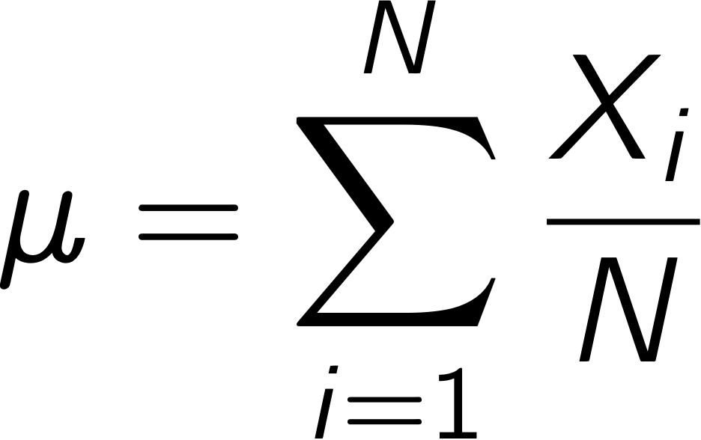
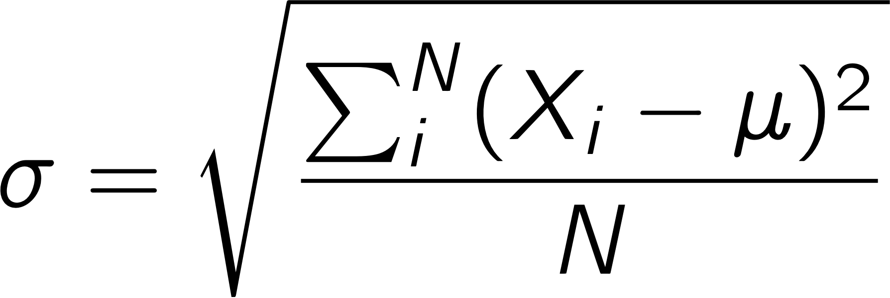
Two key concepts
Population
All possible values of an experimental variable (e.g. all stars in the milky way, all types of enzymes etc.)
Sample
A set of data drawn from a population
Often want to know the mean (𝜇) and standard deviation (𝜎) of a population

Slide 5
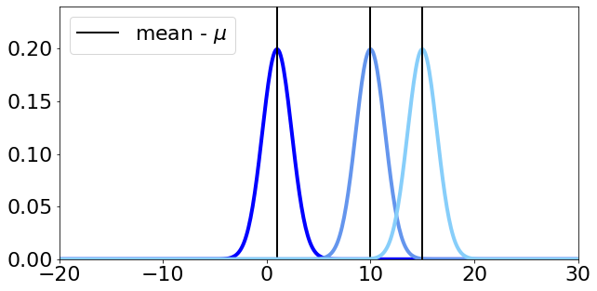
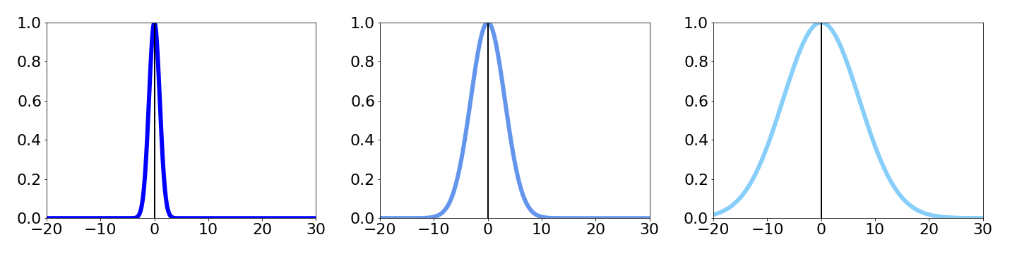
Mean & standard deviation
Mean – location
Standard deviation – spread

Slide 6
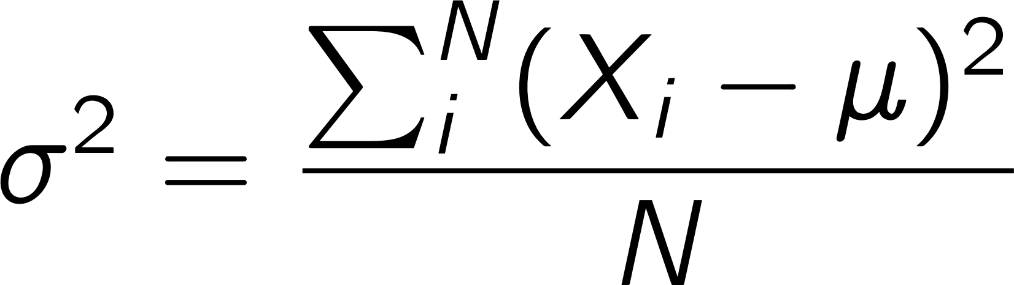

Standard dev. & Variance
Variance is square of std. dev.
± 0.5 𝜎 contains 39% of possible values
± 1 𝜎 contains 68%
± 2 𝜎 contains 95%
± 3 𝜎 contains 99.7%
https://en.wikipedia.org/wiki/Normal_distribution

Slide 7
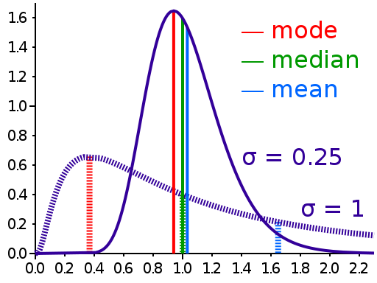
Median vs mean
The median is a value separating the higher half from the lower half of a data sample, a population, or a probability distribution
Median is often more robust
than the mean in the face of
skewed distributions and
outliers

Slide 8


Measuring $μ$, $σ$ ?
Is it possible to obtain the population for an experimental variable?
Is it possible to directly measure the mean (𝜇) and standard deviation (𝜎) of a population

Slide 9
If we had a population ….
Open the L3_Descriptive_Statistics.ipynb notebook

Slide 10
Back to reality
We could estimate the correct mean and standard deviation from samples …

Slide 11
Population samples
Samples are sets of data drawn from the population
Described by their size n (number of data points)
Notation: X indexed by sample subscript, e.g. X₁
How to choose n?

Slide 12
Sampling Bias
Do all values in a population have
the same chance of being selected?
If not, we have bias.
What is an example of bias in sampling?
Example: Assess average level of knowledge of US population based on survey responses from high school students

Slide 13
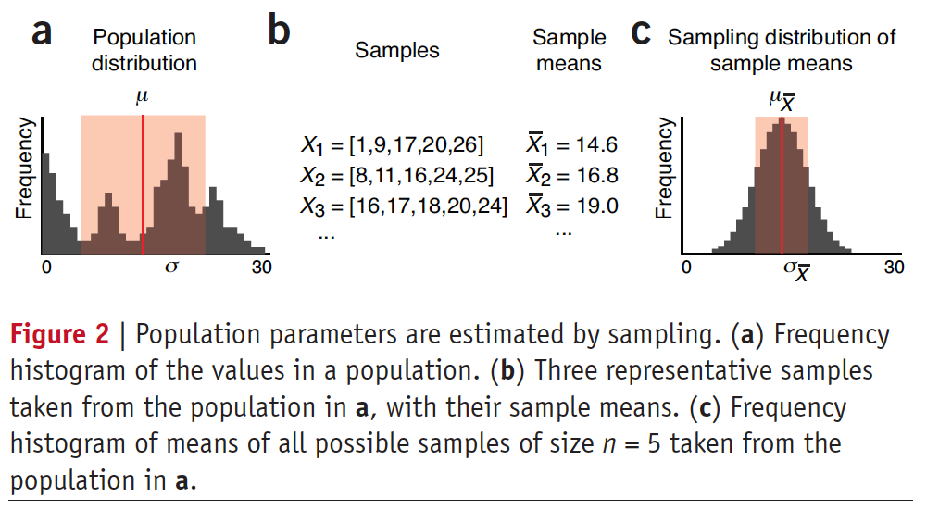
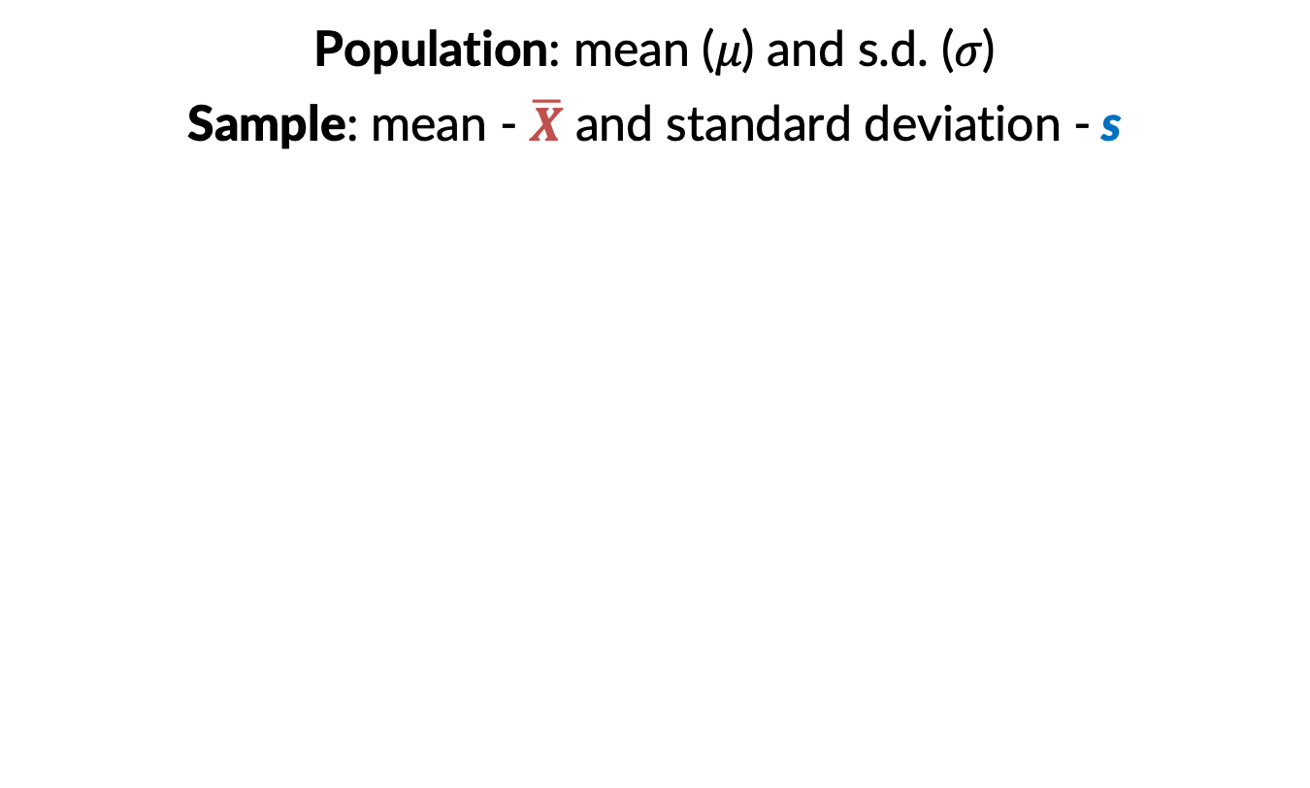
Population samples
Population: mean (𝜇) and s.d. (𝜎)
Sample: mean - $\overline{X}$ and standard deviation - s
Nature, 2013. Importance of being uncertain

Slide 14
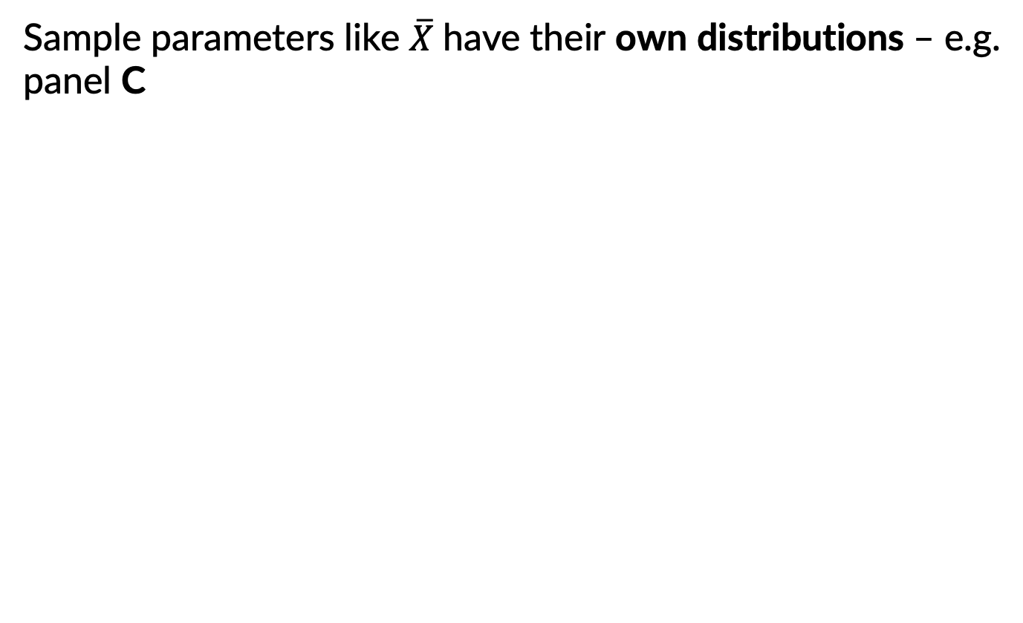
Population samples
Sample parameters like $\overline{X}$have their own distributions – e.g. panel C
Nature, 2013. Importance of being uncertain

Slide 15
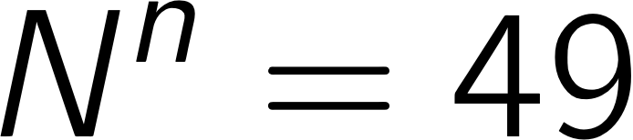
Sampling with replacement
N=7 population values = [12, 13, 14, 15, 16, 17, 18]
Sample with replacement (n=2)
First sample, each item has 1/7 probability
Second sample, each item has 1/7 probability
How many total possibilities (assuming order is important)?
Each time we sample our choice is independent from the prior choice!

Slide 16
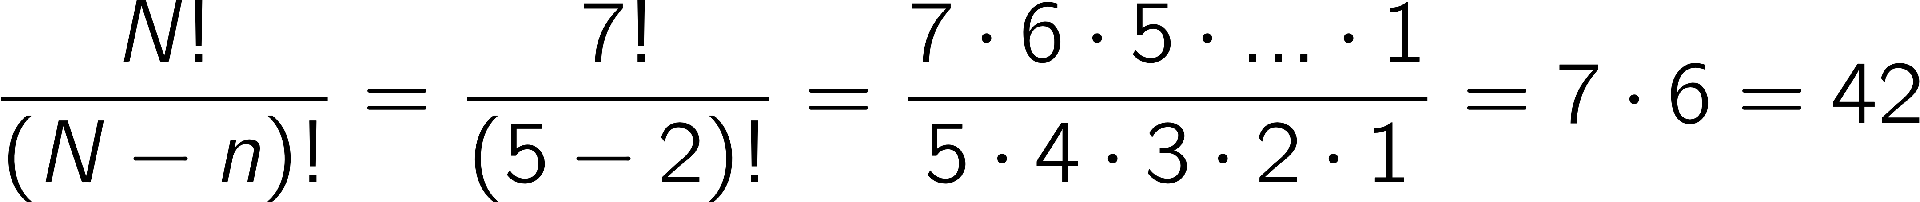
Sampling without replacement
Population values = [12, 13, 14, 15, 16, 17, 18]
Sample without replacement (n=2)
First sample, each item has 1/7 probability
Second sample? 1/6
How many total possibilities (assuming order is important)?
Note: Each time we sample our choice depends on the previous choice!
Notes:
\frac{N!}{(N-n)!}=\frac{7!}{(7-2)!}=\frac{7\cdot 6\cdot 5\cdot...\cdot 1}{5\cdot 4\cdot 3\cdot 2 \cdot 1} = 7\cdot 6 = 42

Slide 17
Will sampling work?
Let’s go back to the notebook

Slide 18
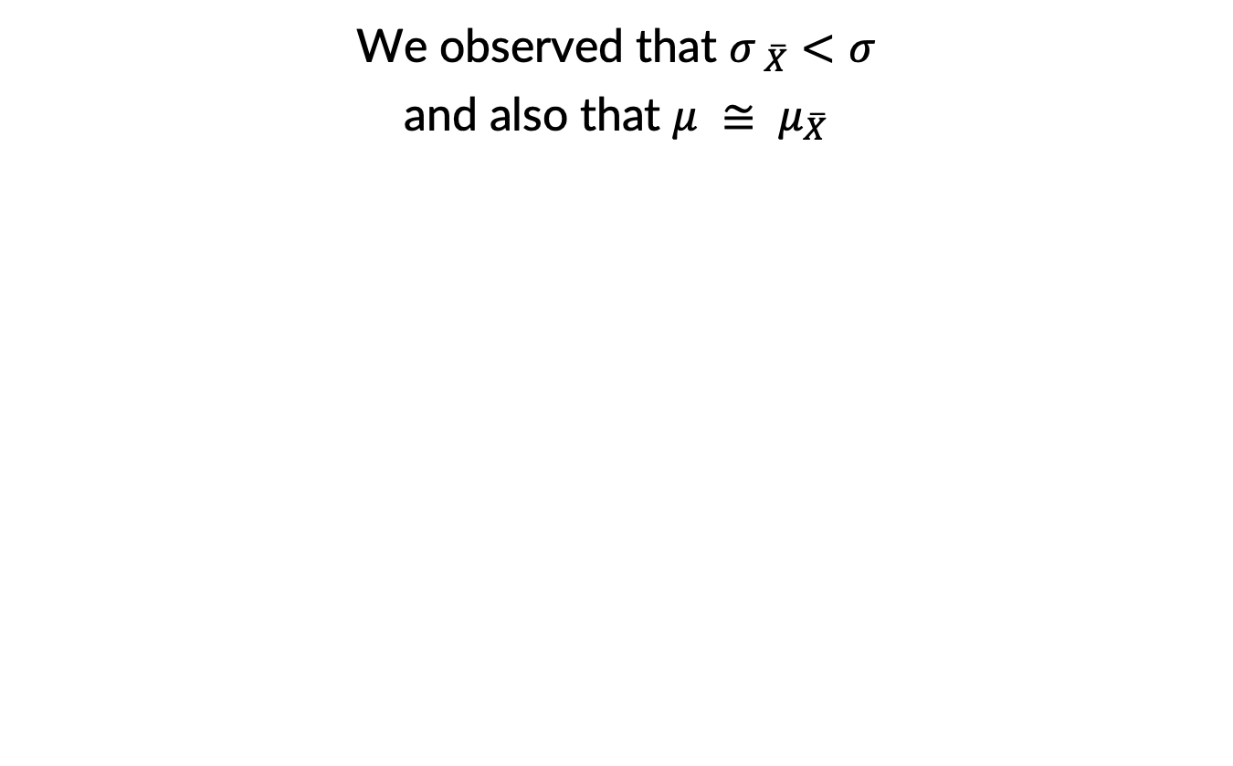
Sampling distributions
We observed that $σ_{ \overline{X}}<σ$
and also that $μ ≅ μ_{\overline{X}}$
Nature, 2013. Importance of being uncertain

Slide 19
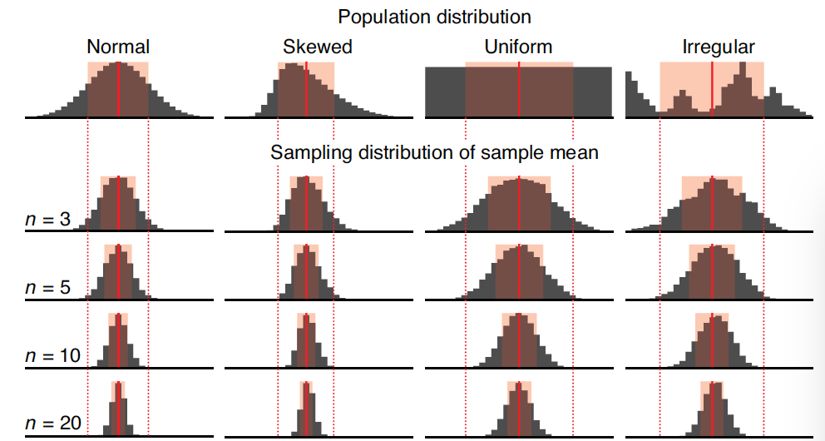
The Central limit theorem
As n increases, the distribution of sample means tends to become a normal distribution, regardless of population distribution shape
Nature, 2013. Importance of being uncertain

Slide 20
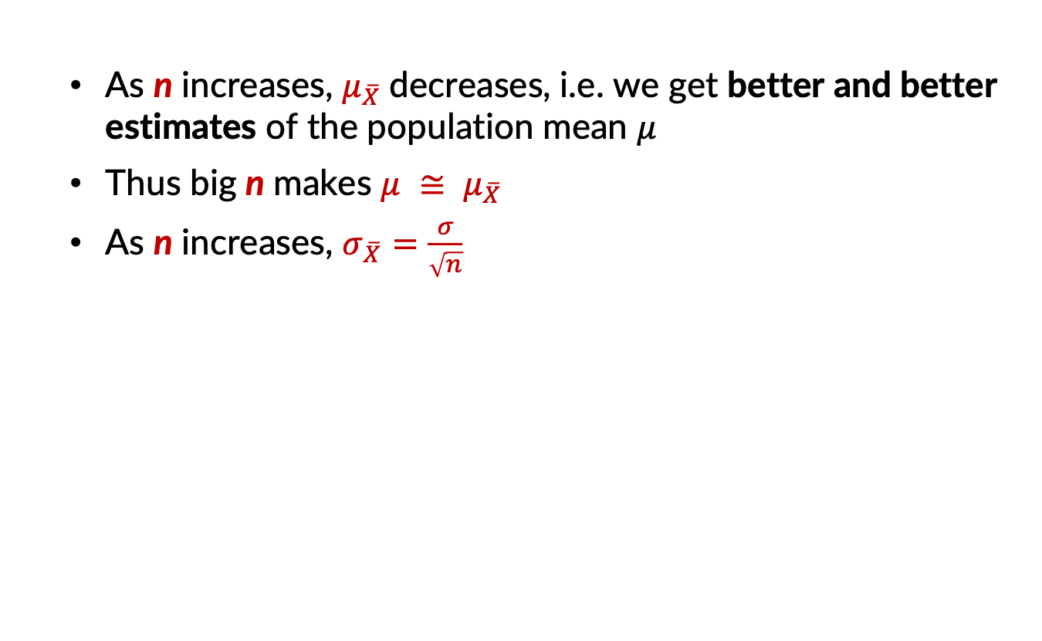
Central limit theorem
As n increases, $μ_{\overline{X}}$decreases, i.e. we get better and better estimates of the population mean 𝜇
Thus big n makes $μ ≅ μ_{\overline{X}}$
As n increases, $σ_{\overline{X}}=\frac{σ}{\sqrt{n}}$
 | n = 50 | n = 2000 | exact
mean | 415.30 | 415.22 | 415.23
Nature, 2013. Importance of being uncertain

Slide 21
Central limit theorem
Increasing sample size improves estimates
Nature, 2013. Importance of being uncertain

Slide 22
That’s all for today!

